Slide 1
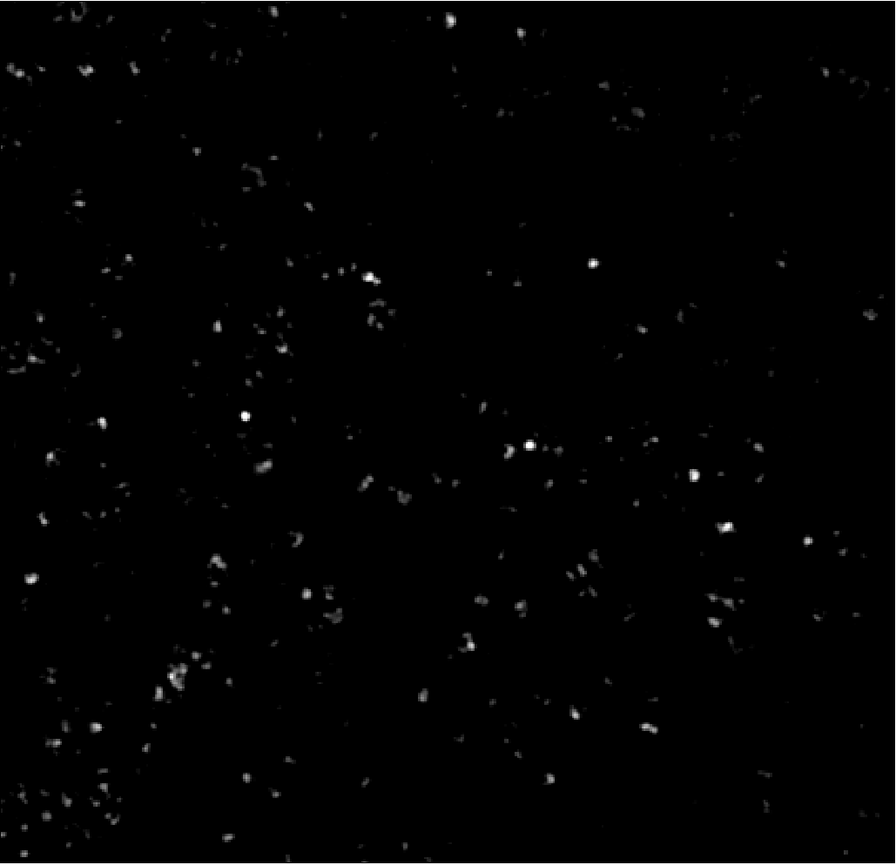
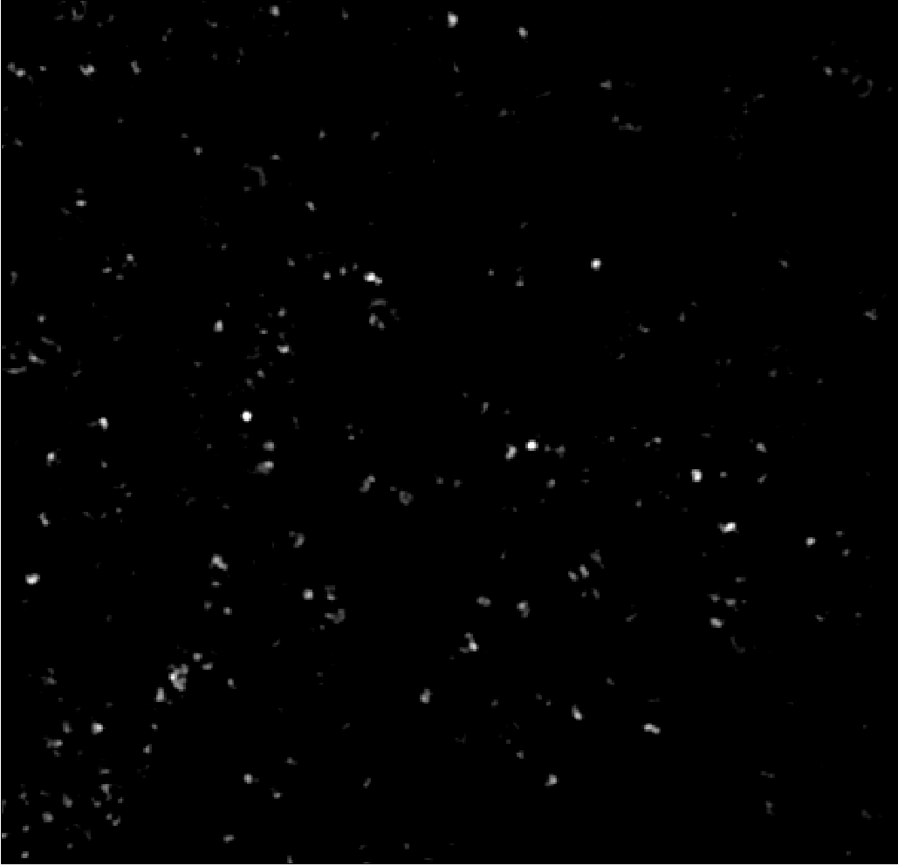
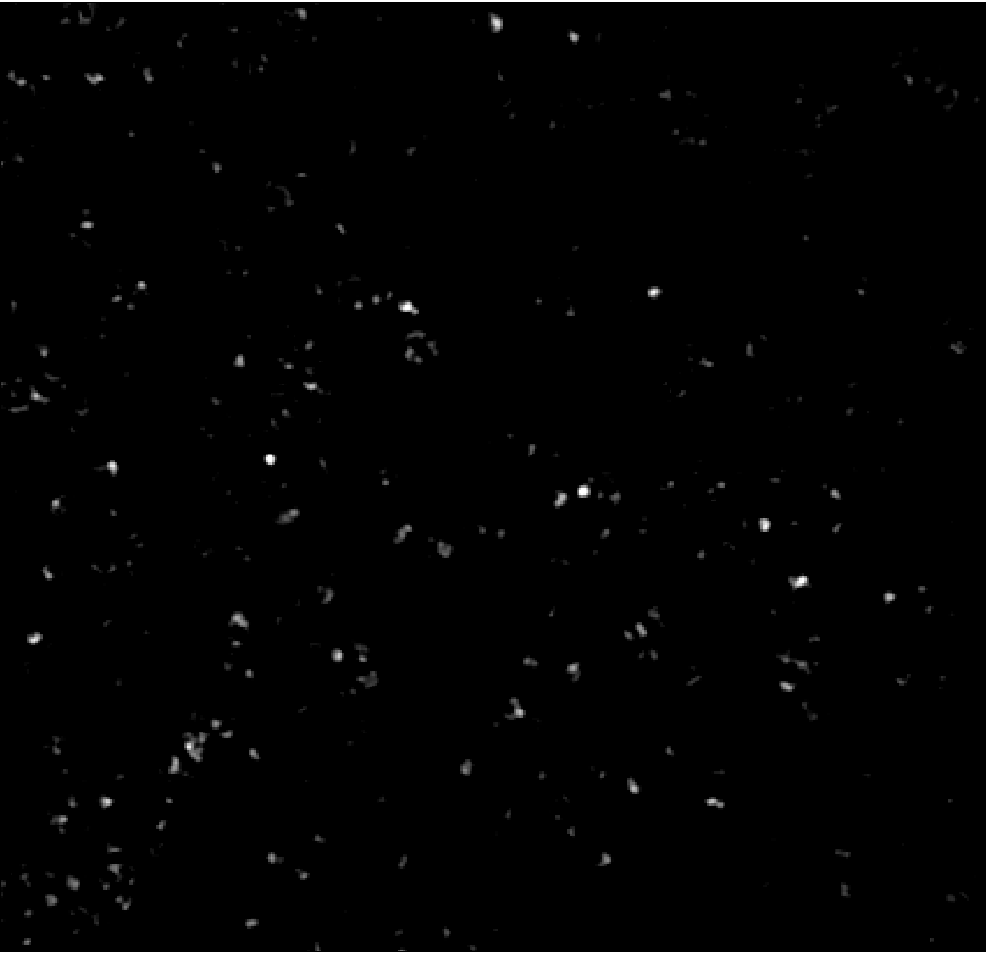
PANORAMA of plasma sample 830A at time: 60 min
PANORAMA
Frame 1
Count: 283
PANORAMA
Frame 2
Count: 284
PANORAMA
Frame 3
Count: 285
PANORAMA
Frame 4
Count: 284
Scale bar: 10 µm

Slide 2
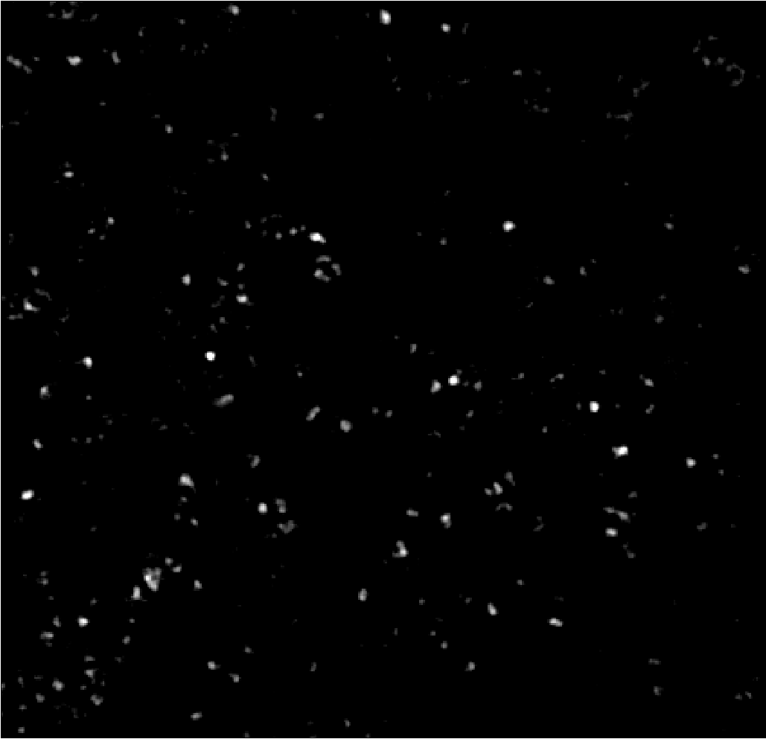
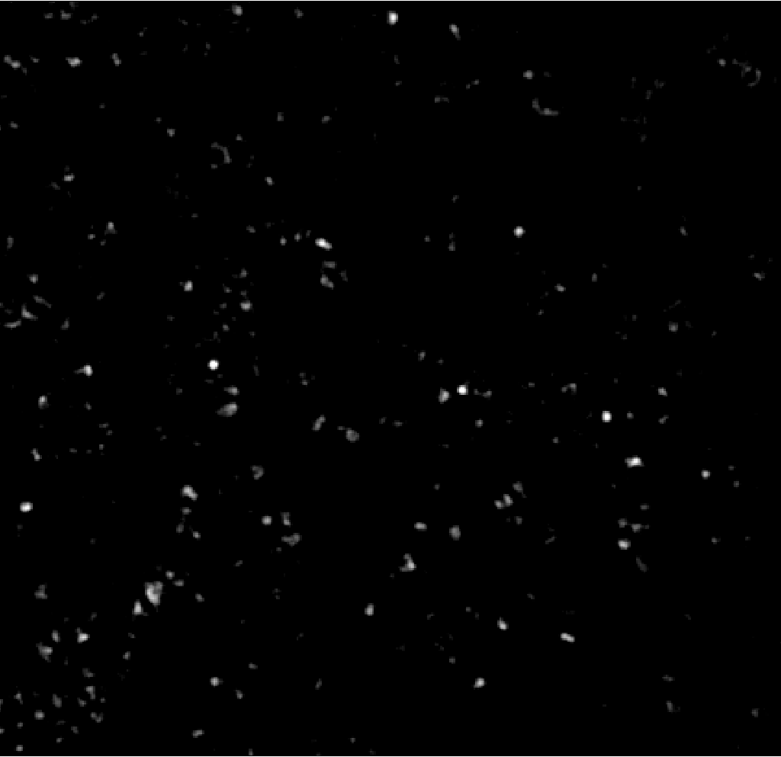
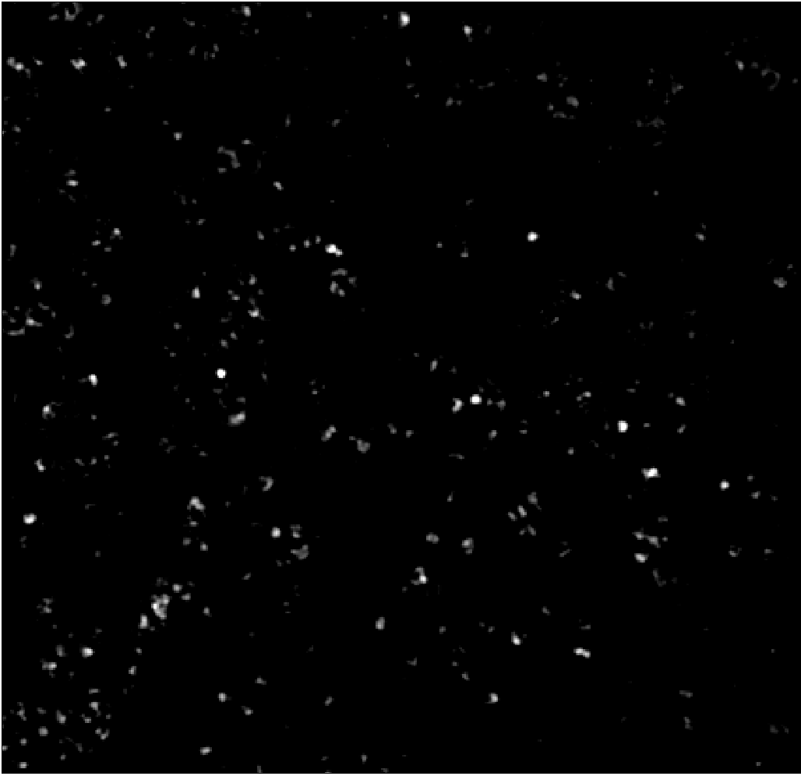
PANORAMA of plasma sample 830A at time: 60 min wash with SD added noise
PANORAMA
Frame 1
Count: 284
PANORAMA
Frame 2
Count: 282
PANORAMA
Frame 3
Count: 284
PANORAMA
Frame 4
Count: 284
Scale bar: 10 µm

Slide 3
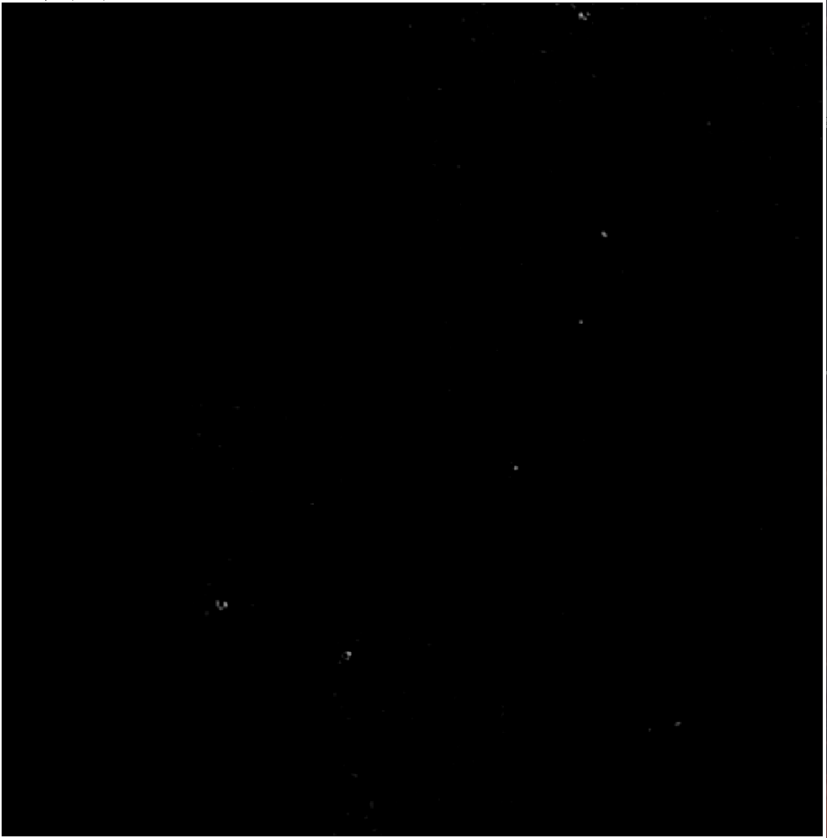
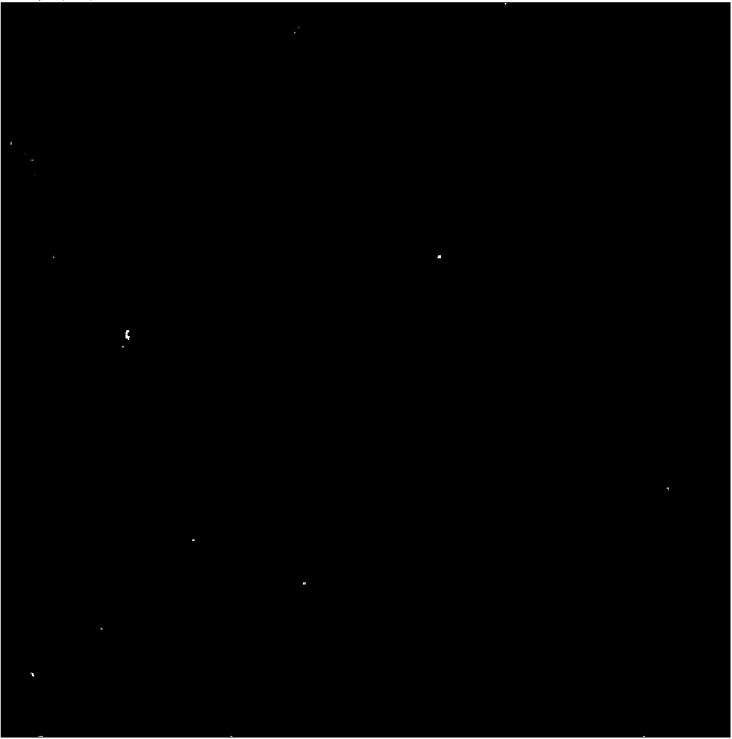
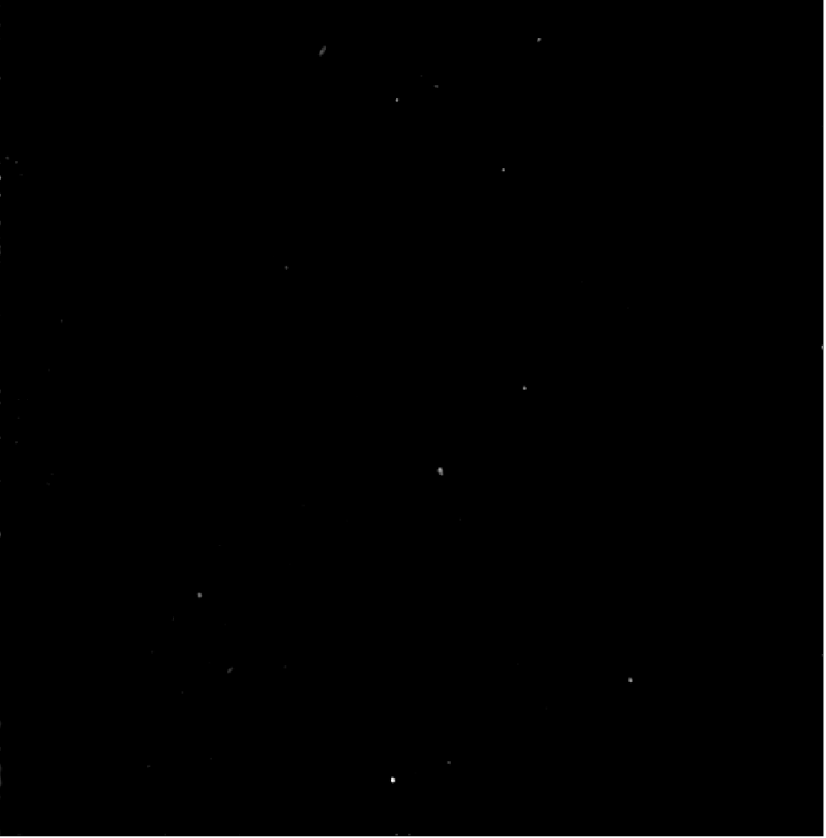
PANORAMA of plasma sample HCR 153 at different times
PANORAMA
Time: 20 min
Count: 6
PANORAMA
Time: 40 min
Count:7
PANORAMA
Time: 60 min
Count: 13
Scale bar: 10 µm

Slide 4
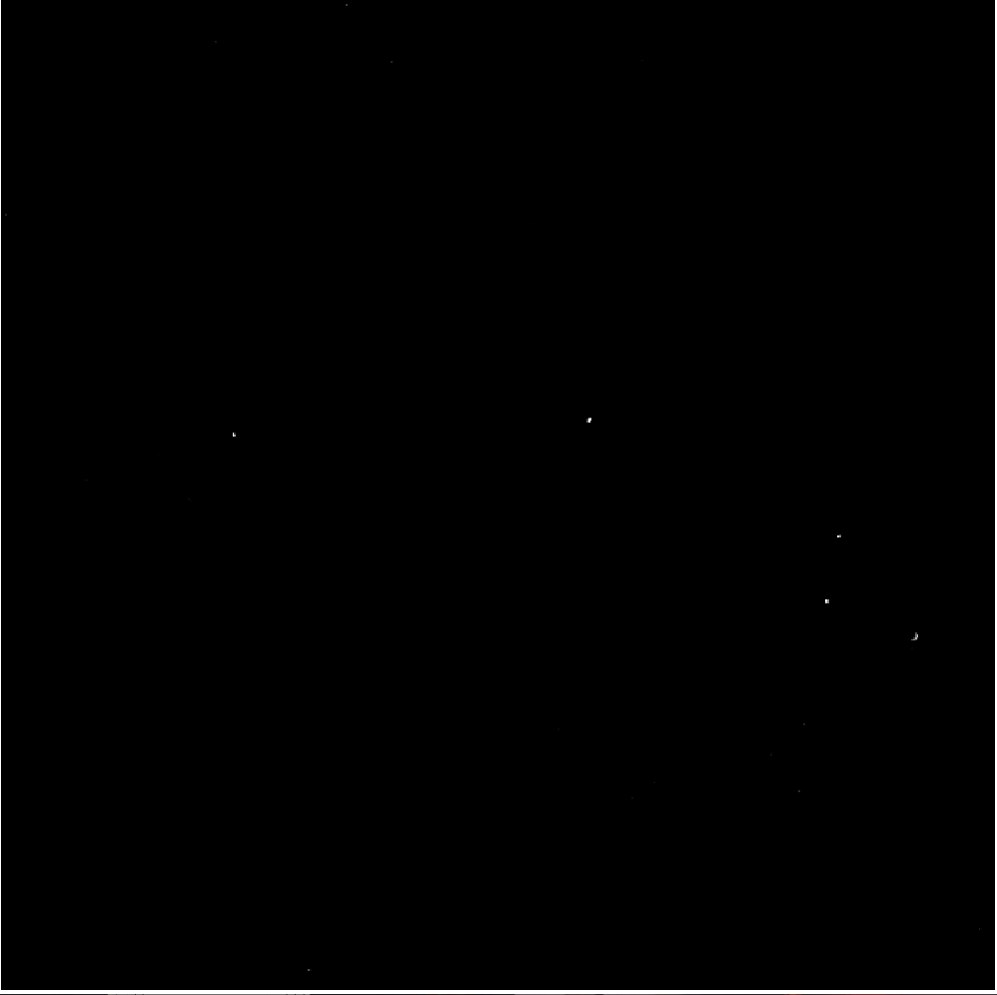

PANORAMA of plasma sample HCR 154 at different times
PANORAMA (1.109 ± 0.018)
Time: 60 min
Count: 13
PANORAMA (1.118 ± 0.022)
Time: 60 min wash
Count: 5
v
PANORAMA Video
Time: 20 min
Count: 24

Slide 5
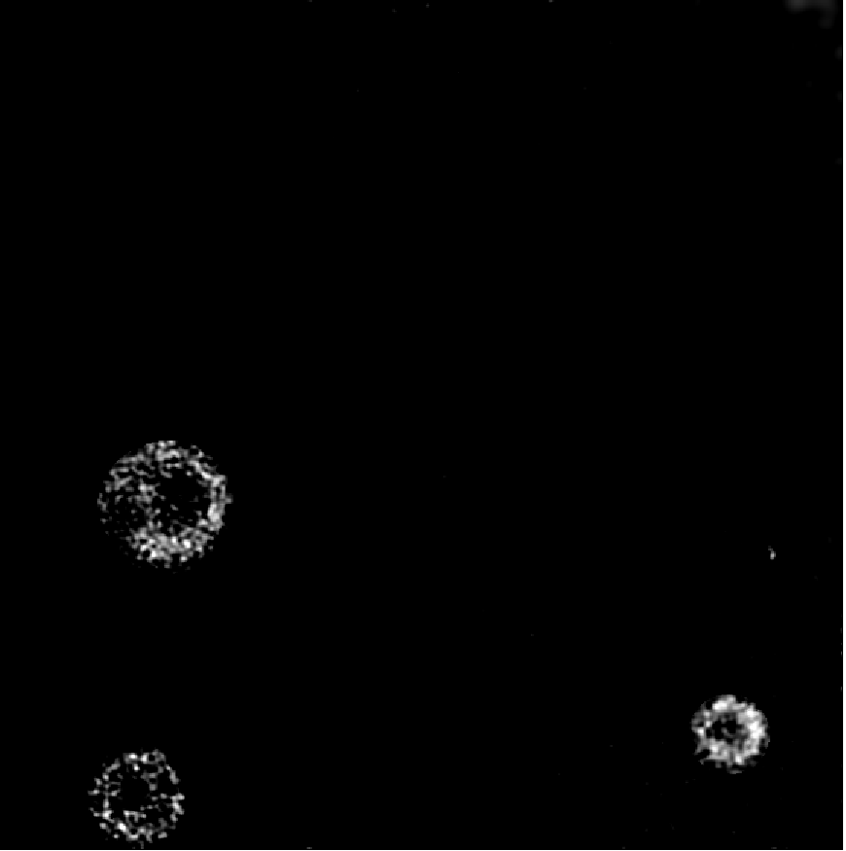
PANORAMA of plasma sample HCR 83 at different times
PANORAMA
Time: 20 min
Count: 4
PANORAMA
Time: 40 min
Count: 4
PANORAMA
Time: 60 min
Count: 4
All particles were washed away.
Scale bar: 10 µm

Slide 6
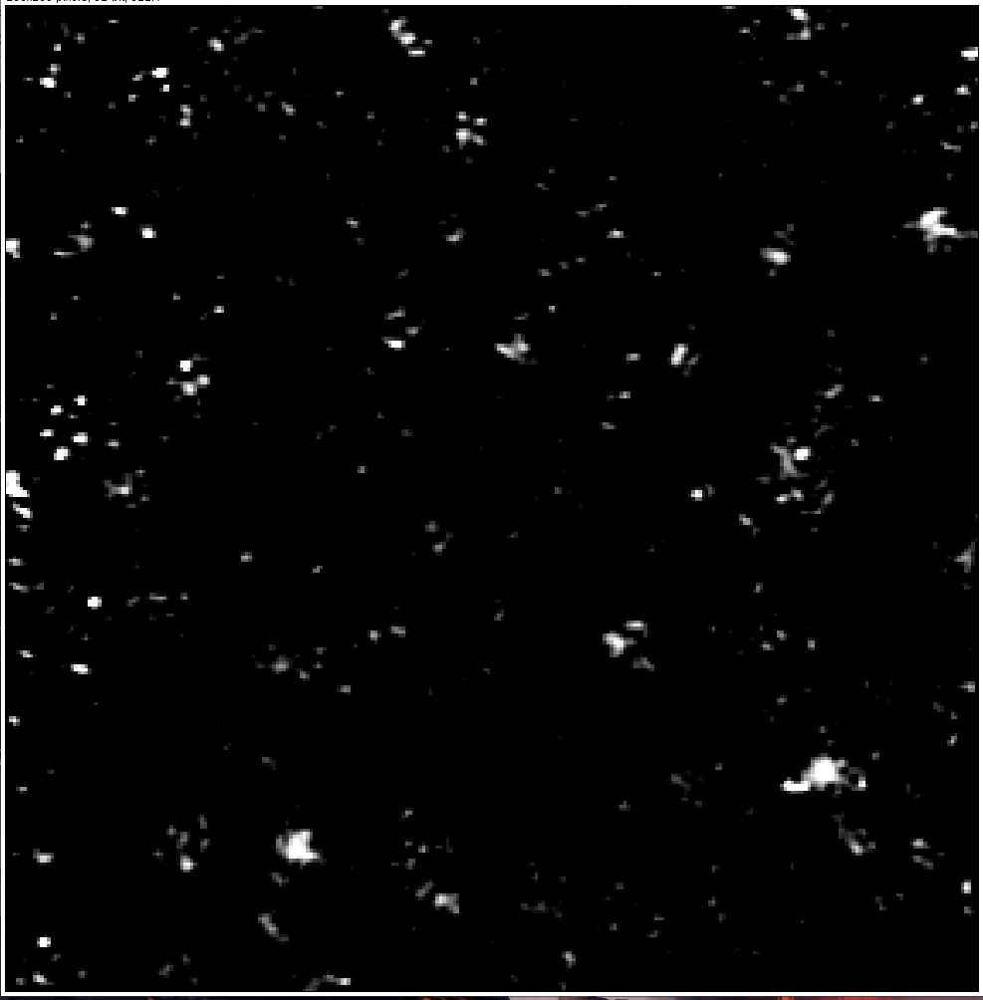
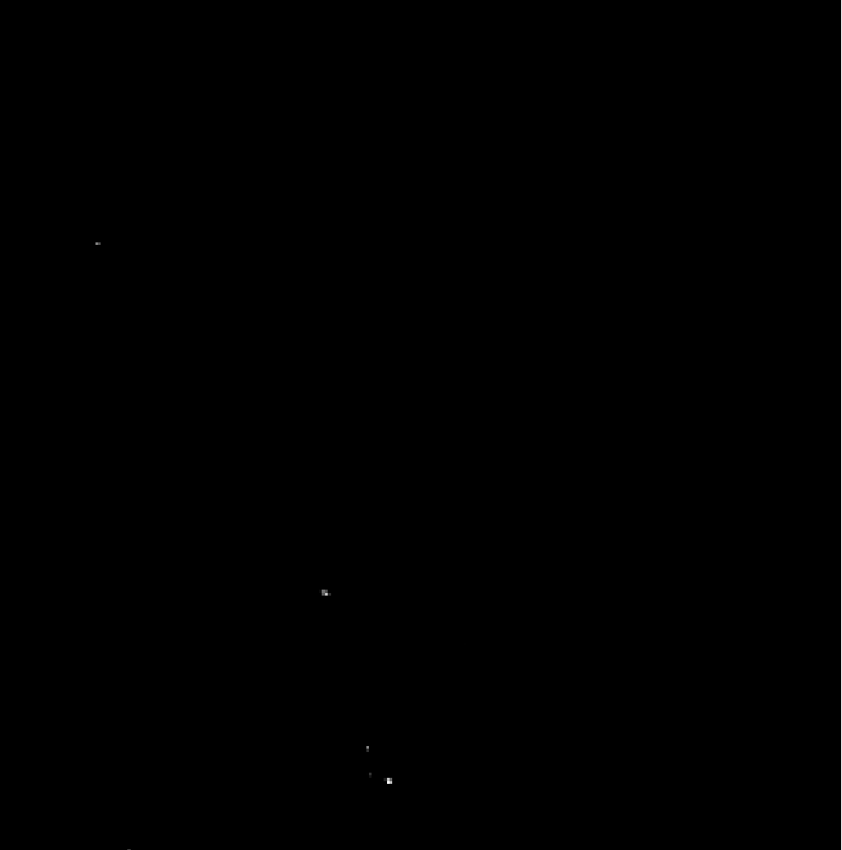
Plasma 1013A with molecular beacon
PANORAMA
Time: 60 min not washed
Count: 512
Fluorescence
Time: 60 min
Count: 5
Scale bar: 5 µm

Slide 7
All particles detected Before/After washing in plasma samples

Slide 8
Particles separated via IR w.r.t. to exosomes detected previously (below 1.14) before and after washing

